Slide 1
Weekly Meeting 4/18/2024
JetRacer Soccer League

Slide 2
ROS/Hardware
Previous Work:
Flashed SD card with Jetpack 5.2.1 (Ubuntu 20.04)
Setup ZED 2 SDK & ROS Noetic
Researched creating ISO/image for cloning packages/OS
Configured jetracer package
Updated CAD with Orin
Future Work:
Create disk ISO
Re-implement servo/motor control
Create PID controller for camera swivel
Utilize SDK for intelligent movement

Slide 3
Movement Strategy
Began planning robot movement from CV outputs
Worked on determining movement strategy based on unity model
Continue to generate movement strategy
Determine method of angle and speed calculation with minimum latency

Slide 4
CV
Previous work:
Finished training with new dataset
Future work:
Test out new CV with yolov8 and check if object detection needs more training
Record more videos and annotate more pictures with the blue car

Slide 5
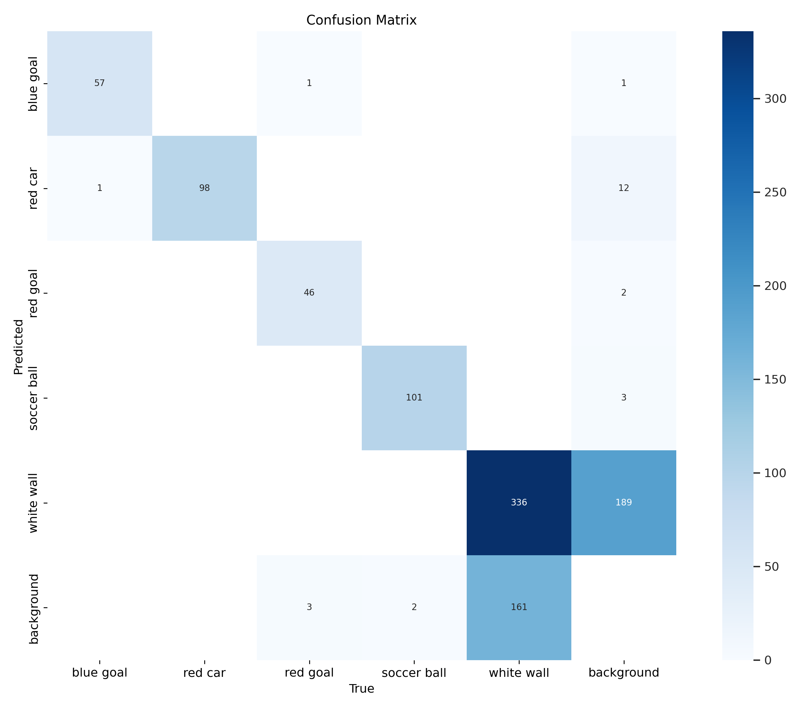
CV

Slide 6
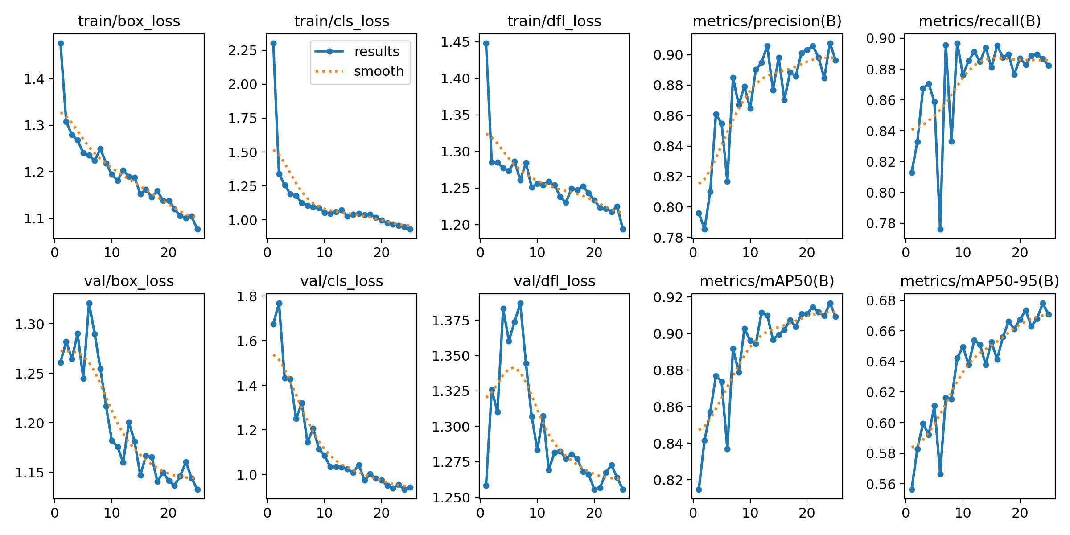
CV

